Slide 2
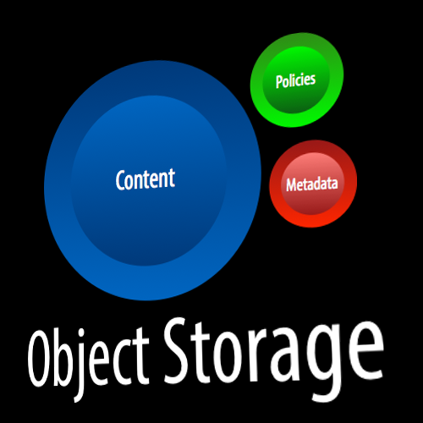
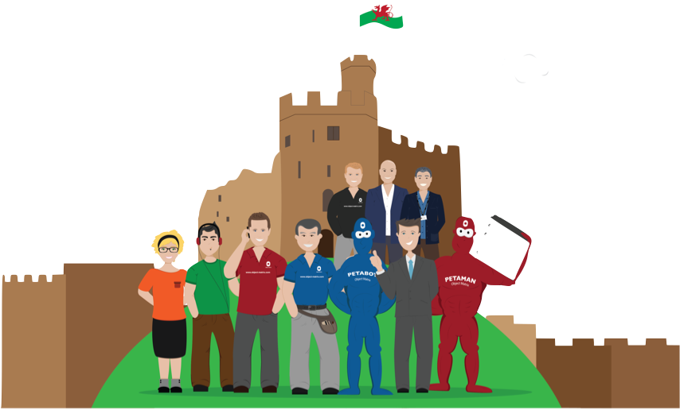
Company
UK based IT software company started, 2003
Employees with clustered object storage background
Recognised the move to disk-based archiving and the need to address that space with new products
Flagship product: MatrixStore
Object Based Storage Technology
Notes:
Employees are ex-EMC/Hitachi with legacy in clustered object based storage.

Slide 3
Customers including:
Notes:
Using MatrixStore in various processes from rushes protection to long term availability of digital content for on demand workflows.

Slide 4
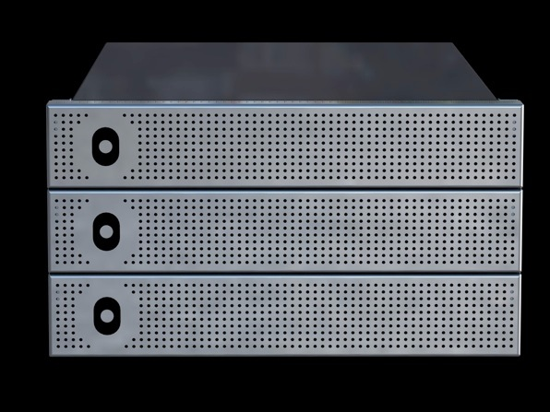
A scalable nearline digital preservation platform
Notes:
MatrixStore is the secure, scalable and searchable nearline storage platform from Object Matrix.

Slide 5
A Nearline Archive for File Based Workflows
Proven Object Storage that Protects Data & Metadata
Self-Managing Archive
Enforces Storage Policies & Data Security
Non-Proprietary Platforms and Formats
Easy to Manage and Cost Effective
Built in Disaster Recovery and Business Continuity
Scale as you grow
Complements existing technologies and infrastructure
Integrated into customer workflows through APIs
Process & enrich content in place (e.g AS11 metadata extraction)
A central hub in your ecosystem
Notes:
MatrixStore is software that turns off the shelf, commodity storage servers into a secure, management free and scalable storage platform.

Slide 6
Nearline & Archive Storage
Online
Promo Teams
Admin Teams
Client Access
Remote Access
Cost per TB: $$$$$$$$
Guaranteed Bandwidth
Nearline
DAMs
MAMs
PAMs
VOD
Playout
Transcoders
Avid
Final Cut
Adobe
EVS
AutoDesk
Quantel
Cost per TB: $$$$
Guarantees data will be there
Deep Archive
Cost per TB: $$$
Deep Offsite Protection for data
with low or no access requirements
Notes:
MatrixStore is a nearline solution that enables multiple workflows from ingest to VOD.
Should be able to rough cut from it
Keep it available as temp store
Provide digital preservation platform for content that needs to be online forever.
Should also be available to all workflows

Slide 7
Products

Slide 8
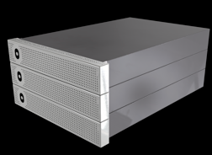
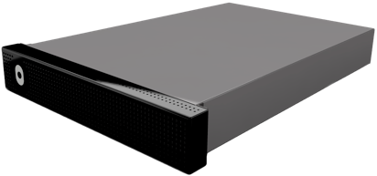
Enterprise
Quattro
Capacity | 12TB to Petabytes | 24TB to 128TB
Node Capacity (Raw TB) | 12, 24, 48, 72, 96, 144. 216 | 24, 32
Minimum Configuration | 3 MatrixStore Nodes | 1 MatrixStore Quattro Unit
Protection Policies | Single, Dual (local and remote) | Single, Dual (local and remote)
RAID Protection | RAID6 | None
Node Dimensions | 2u, 4u (rack mounted) | 2u
Node Power | Dual (Redundant) | Dual (Redundant)
Node Connectivity | GigE or 10GigE | 16 GigE Ports
Notes:
Storage Appliances.
1. Enterprise MatrixStore . In house use for rushes, parking and content distribution.
2. MatrixStore Quattro. In house, on location, OB van etc.

Slide 9
Object Matrix Applications
Release
Q4 2015
Release
Q1 2016
Mini DAM/MAM | MatrixStore File System | Deep Archive Service | FTP Application | Avid Interplay Plugin | Web Interface | Amazon S3 Interface
Windows/Mac/Linux | Windows/Mac/Linux | Windows | Windows/Mac | Windows | MatrixStore hub | MatrixStore hub
Free | Free/POA | POA | POA | POA | POA | Free
Notes:
Client Tools
1. DropSpot
2. MXFS
3. MatrixStoreConnect (FTP)
4. Move2 (backup MatrixStore content to deep archive like ODA or LTO)
5. InterConnect

Slide 10
Application Programming Interface
Object Matrix Applications
3rd party Ingest, MAM, DAM,
PAM, Transcode, HSM, VOD &
home grown Applications
MatrixStore API
MatrixStore API
- C or Java
- Data & Metadata operations
Provides Seamless Integrations
S3 wrapper also availble Q1 2016
MatrixStore
Notes:
1. Access content using Object Matrix applications
2. Use the MatrixStore API or access applications (MXFS/FTP) to integration with 3rd party or home grown applications

Slide 11
Client Connectivity
No Client Software Required
Production Storage
Object Matrix Hub
SMB etc
MatrixStore API
Integrated Applications
Each node needs two ports on the customer switch
Customer Network
GigE or 10GigE
FTP Server
Object Matrix MatrixStore (local or remote)
Windows Clients
Mac Clients
Linux Clients
Direct Access with MXFS for
fast parallell acces
DropSpot for metadata tagging and search
Dual
RJ45 or SFP+ per node
Internal Network: GigE or 10GigE
IPMI Network (Switch)

Slide 12
Positioning
(on premises or hosted)

Slide 13
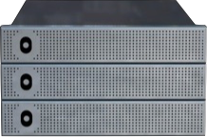
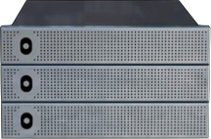
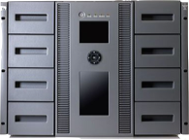
Ingest, Transform, Parking, Archive, Distribute
Production Storage
Rushes Vault
- Two local Copies
- Data locked down for 6 months
- Data accessible from file system
Playout
Transcode
edit
Search and Retrieve
Ethernet
Parking Vault
- Two local Copies
- Data locked down for 6 months
- Data accessible from file system
Send to LTO
Re-purpose Content
Any NLE
Internet
Archive Vault
Archive
- One local Copy, One remote copy
- Data locked down for 12 months
- Data accessible from file system
Rushes
Archive
Parked
Remote MatrixStore for
Disaster Recovery &
Business Continuity
(more details later in presentation)
LTO/ODA Library
MatrixStore
Notes:
Online Archive
Video on Demand
Distribution platforms
Content owners
Show reels
Popular Content or regularly used clips

Slide 14
Who uses it and how?

Slide 15
Nearline and Offsite Archive
Using DropSpot (with Forms) or a MAM like Cantemo Portal. Content is sent to MatrixStore which can be hosted locally or in a remote data centre.
Optionally (Guardian) you can replicate vaults to a 3rd location
Production Storage
Video Vault
Graphics
DropSpot
MAM
Dedicated Line
network
MatrixStore
Docklands
Re-Purpose Location
Dedicated Line
Central London Offices
Use DropSpot to ingest and add metadata. Use MXFS to browse content in the nearline.
Video Vault
MatrixStore
Bracknell
Notes:
MAM workflows with business continuity (Many supported MAMs)
MatrixStore onsite or offsite or both

Slide 16
Nearline for Interplay
Production Storage
Drag and Drop Clips/Projects
into ‘To Be Archived’ or
‘To Be Restored’ Folder.
InterConnect moves the data to
and from MatrixStore in the
background updating Interplay
via the Web Services API.
Avid Interplay
MAM
InterConnect
edit
Search and Retrieve
Move to/from nearline
Ethernet
Drag and Drop
Any NLE
Re-Purpose Location
Use DropSpot to ingest and add metadata. Use MXFS to browse content in the nearline.
Rushes
Parked Suff
1.5 Petabytes across two sites
MatrixStore
Notes:
Parking Space for ongoing projects.
Avid: DropSpot or InterConnect
Other Workflows: DropSpot, MXFS or partner applications

Slide 17
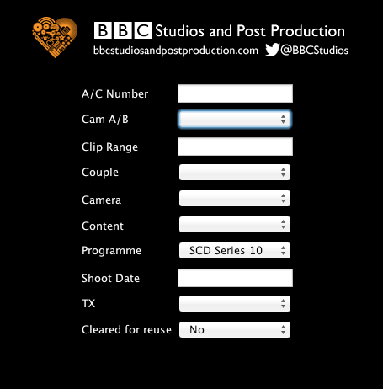
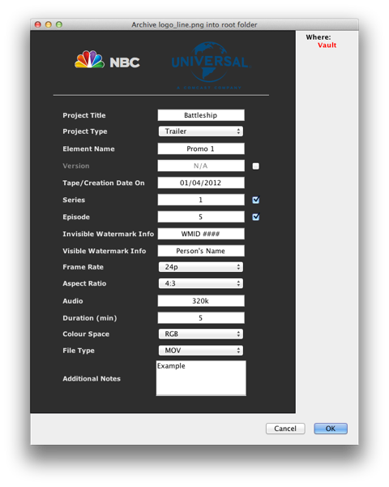
Card Ingest Forms for Non-MAM workflows
Custom metadata tagging and search forms offered by DropSpot application

Slide 18
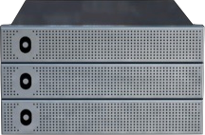
HDV
Production Storage
DV/SD
HD-SDI
Ingest
Transcode
XDCAM
P2
edit
Proxies
Simple Scene Selection
Ethernet
Consolidate to Production Storage
Any NLE
Rushes
Ingest Using DropSpot
DropSpot to ingest
add metadata using forms interface
audits generated including MD5 of each object stored
LTO/ODA Library
MatrixStore
Notes:
1. Content ingested from Cards or ingest appliances using DropSpot or MXFS from Object Matrix
2. Full resolution sent to MatrixStore low resolution to Production storage (ISIS, XSAN etc)
3. Content can be accessed direct from MatrixStore via MXFS for browse before moving to production storage
4. DropSpot forms interface developed to enforce meaningful metadata entry
5. Transcode rushes to production storage

Slide 19
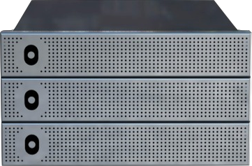
Ingest location
Content landed in dual copy MatrixStore vault
Transcode
Audio
Graphics
Rhozet Farm reads from vault and writes to new single copy proxy vault
Re-Purpose
Interplay Archive
Ingest
Rhozet Farm reads from vault and writes to new single copy proxy vault
Interplay
Graphics & Audio
Proxies
DropSpot & MXFS used to provide secure shared area.
move2LTO
MatrixStore
Older content moved to LTO
Notes:
Multiple Tenancy. Many workflows, departments of projects independently using the same physical platform
Typically start with one workflow then add/grow as needed

Slide 20
1.4 Petabytes
Future Proof Capacity Growth
British Telecom has 382* 24TB nodes, 2*36TB nodes and 12*48TB nodes for the BT Vision VOD platform.
There are 8 generations of underlying hardware in the current cluster.
1st gen
2nd gen
3rd gen
4th gen
5th gen
6th gen
7th gen
8th gen
August 2010
January 2011
September 2011
February 2012
December 2012
September 2013
July 2014
April 2015
100 TB
1.4PB
Notes:
Proves MatrixStore ability to add nodes of any supported type or size.

Slide 21
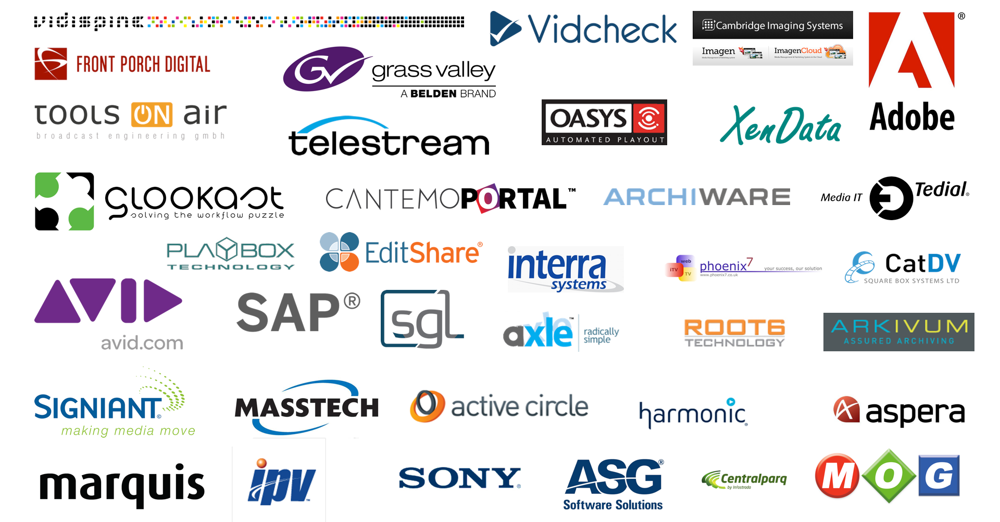
Partners including:

Slide 22
Disaster Recovery

Slide 23
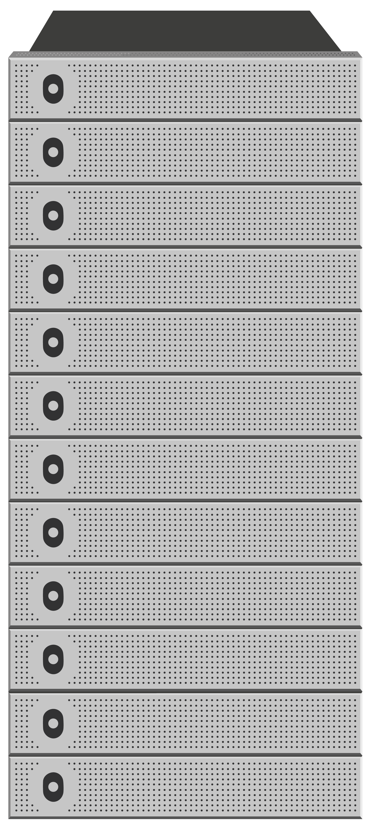
Vault based
Flexible approach ensures only mission critical data is replicated
Choice of data redundancy levels on both sites
Asynchronous
Data is protected in two (local) locations instantly
Copies then made to disaster recovery site asynchronously
Self Healing
Data is copied between sites during localised loss of availability thus ensuring data protection policies always adhered to
Semi-automated
Protection of content to DR site is completely automated
Simple administration required on disaster recovery site when primary site if offline
Replicate
Two Copies
Local only
Do not
replicate
Replicate
One Copy
©Object Matrix Ltd 2015. All Rights Reserved. Private & confidential

Slide 24
Disaster Recovery Location Options
On Premises Disaster Recovery
(Platforms owned by you in your premises. The most popular option)
Hosted Private Cloud
(Platforms owned by you in a mixture of your premises and 3rd party data centres )
Hosted Cloud
(Source platform owned by you. Replication platform owned and storage offered as a service by a third party)
©Object Matrix Ltd 2015. All Rights Reserved. Private & confidential

Slide 25
On Premises Disaster Recovery
(Where both premises are locations owned and operated by the organisation)
MatrixStore clusters are owned by the organisation and located in premises operated by the organisation
Vaults in both locations can be replicated to the remote location
Big Corp London HQ
Big Corp Cardiff Office
London
Primary
Vault
London
DR
Vault
MatrixStore Replication
Cardiff
DR
Vault
Cardiff
Primary
Vault
MatrixStore Replication
©Object Matrix Ltd 2015. All Rights Reserved. Private & confidential

Slide 26
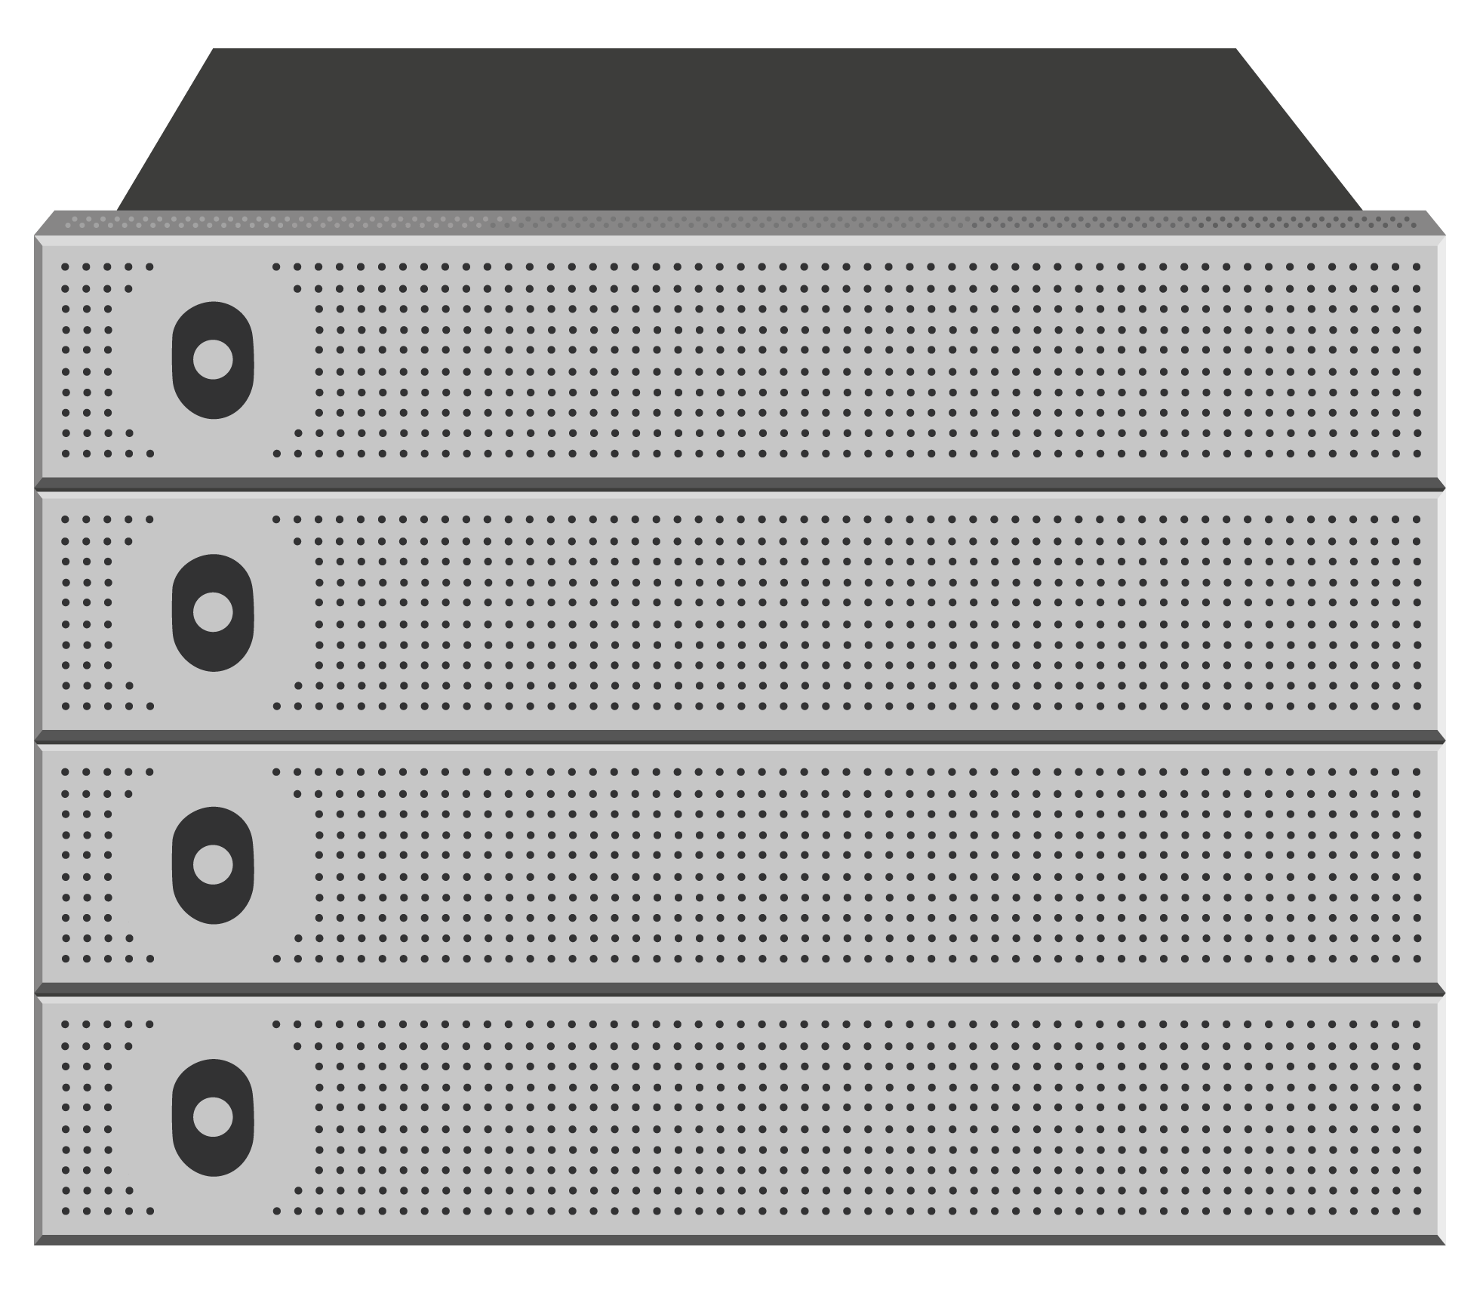
2. Hosted Private Cloud for Disaster Recovery
(Where disaster recovery location is hosted in a 3rd party data centre)
Primary MatrixStore Clusters are owned by the organisation and located in premises operated by the organisation
Data in vaults from both locations are replicated to MatrixStore Cluster owned by the organisation but hosted in a 3rd party data centre
Replication is vault based so it is possible to replicate many vault from many clusters to a centralised, offsite, MatrixStore cluster
Big Corp London HQ
Big Corp DR Cluster hosted
in 3rd party data centre
London
Primary
Vault
London
DR
Vault
MatrixStore Replication
Big Corp Cardiff Office
Cardiff
DR
Vault
Cardiff
Primary
Vault
MatrixStore Replication
©Object Matrix Ltd 2015. All Rights Reserved. Private & confidential

Slide 27
3. Hosted Cloud for Disaster Recovery
(Where disaster recovery vaults are hosted by a 3rd party service provider)
A Corp Bath
Big Corp London HQ
DR Service offered by 3rd party
Bath
Primary
Vault
London
Primary
Vault
Big Corp
DR
Vault
MatrixStore Replication
Primary MatrixStore Clusters are owned by multiple organisations and located in premises operated by those organisations
Data in vaults from all organisations are replicated to a MatrixStore cluster owned and operated by a 3rd party service provider
Small Corp Bristol
A Corp
DR
Vault
Cardiff
Primary
Vault
MatrixStore Replication
Small Corp
DR
Vault
©Object Matrix Ltd 2015. All Rights Reserved. Private & confidential

Slide 28
Disaster Recovery & Business Continuity for Avid Interplay Workflows
©Object Matrix Ltd 2015. All Rights Reserved. Private & confidential

Slide 29
The MatrixStore Disaster Recovery solution for Avid Interplay ensures all your assets can be available 24/7 at local or remote locations
InterConnect provides the ability to select assets from the MatrixStore disaster recovery cluster when you need them most
Get only the content you need, when you need it
Know that all the media and metadata from all your projects are safe in two locations
Use DropSpot and MatrixStore to tag, archive and replicate Avid project files from multiple workstations and locations
The Object Matrix solution is flexible, scalable and proven
©Object Matrix Ltd 2015. All Rights Reserved. Private & confidential

Slide 30
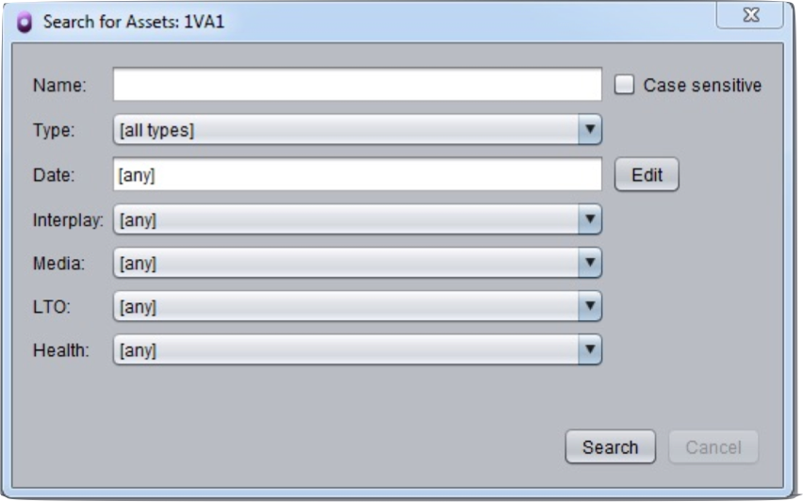
The Workflow
Manually or Automatically Archive assets using Interplay Access with InterConnect configured
MatrixStore Asynchronously replicates the media and selected metadata to the disaster recovery site
At the Disaster Recovery site use the InterConnect Explorer to search for and restore selected assets to the clean Interplay
Simply open the project in Media Composer and your editors are working again
That simple
InterConnect Explorer - search for archive assets to restore
©Object Matrix Ltd 2015. All Rights Reserved. Private & confidential

Slide 31
Business Continuity Elements
Primary Location
Interplay
Avid PAM
Interplay
InterConnect
Archive & Parking Application (from Object Matrix) for Avid Interplay
Avid Web Services API
MatrixStore Vault. Analogous to Avid Workspace. Create and enforce storage, protection and business rules. Very flexible approach to managing your content
InterConnect
Enterprise MatrixStore Cluster. The proven and trusted object storage platform. MatrixStore scales in capacity, performance and workflows. Business Continuity built in via MatrixStore Replication
Vault
Avid Web Services API
Avid API for interrogating and manipulating the AVID Interplay PAM
DropSpot MAM. Simple asset management for tagging, archiving and finding content in a MatrixStore cluster. Can also be used to retrieve content if the Interplay database is not available
©Object Matrix Ltd 2015. All Rights Reserved. Private & confidential

Slide 32
1. Offsite With MatrixStore Replication
(Where Rio is a production centre with the DR site in Santa Fe)
Content can be manually or automatically archived using Interconnect from Object Matrix
MatrixStore Replication asynchronously replicates vault contents from the local cluster to the disaster recovery site
InterConnect on the disaster recovery site can be used to search for projects or clips in the replica cluster
The chosen clips can then be checked in to the empty Interplay Engine and the assets restored to the ISIS
Re-Connect the Avid Project file
Work
Rio
Santa Fe
Interplay
Interplay
Avid Web Services API
Avid Web Services API
InterConnect
InterConnect
St Angel
Dual
Copy
Vault
Santa Fe
Replica
Vault
MatrixStore Replication
©Object Matrix Ltd 2015. All Rights Reserved. Private & confidential

Slide 33
2. Multiple Interplays
(Where any archived asset form multiple Interplay platforms can be restored to a single Interplay platform at the DR site)
News
Soap
Sports
Disaster Recovery Site
It is possible to have multiple Interplay instances archiving to multiple vaults in a single MatrixStore cluster
Each vault replicates its own data
Only restore the clips needed at the disaster recovery site
No need to replicate and re-install databases
Object Matrix approach is flexible and scalable
Interplay
Interplay
Interplay
Interplay
Avid Web Services API
Avid Web Services API
InterConnect
InterConnect
InterConnect
InterConnect
Soap Vault
Soap
Replica
News Vault
News
Replica
MatrixStore Replication
Sports Vault
Sports
Replica
©Object Matrix Ltd 2015. All Rights Reserved. Private & confidential

Slide 34
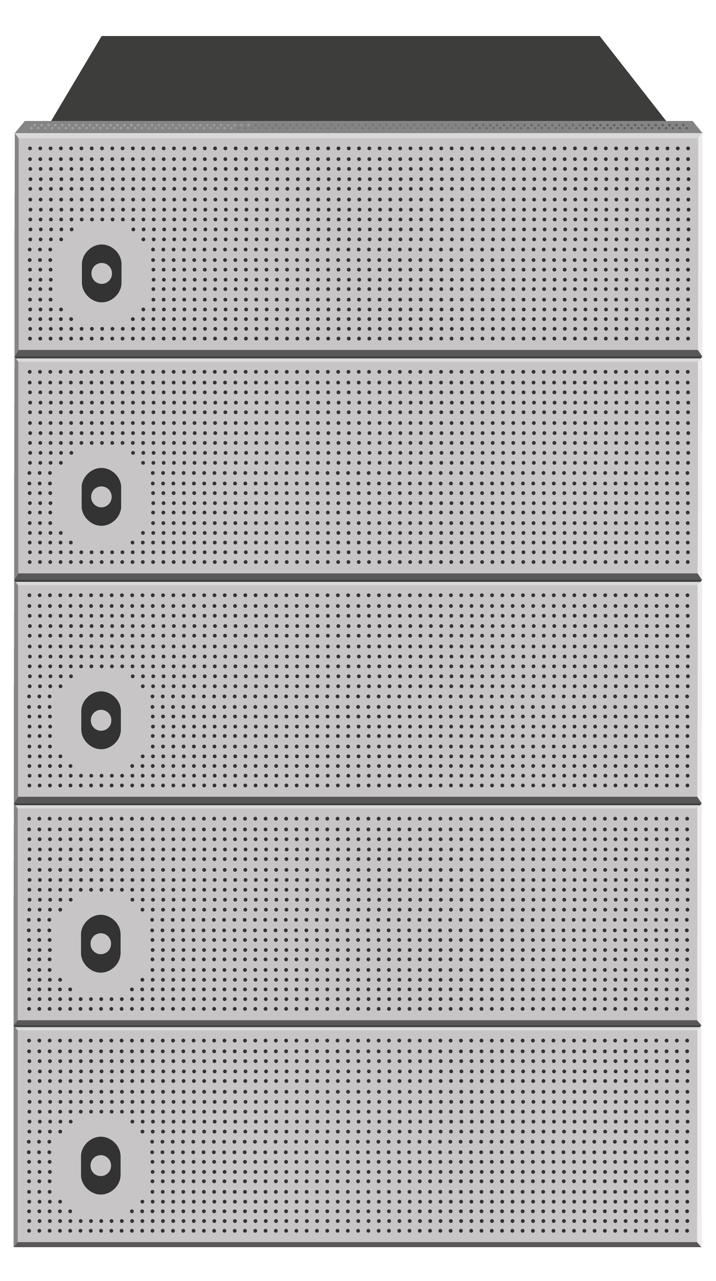
Archive and Replicate Project Files
(Tag, archive and find project files. Simple but essential)
Disaster Recovery Site
Editors may be in local site or using the Avid cloud interface
Project files can be archived using DropSpot or MXFS from Object Matrix
Tagging those project files with meaningful metadata will make them easier to find at the disaster recovery site
Custome DropSpot Forms can be developed to ensure key metadata is entered correctly
Archive Project Files using MXFS (Fie System) or DropSpot with custom form installed on each Avid client
Search for Project Files using MXFS (Fie System) or DropSpot
Avid
Project Files
Avid
Project Files
MatrixStore Replication
MatrixStore
MatrixStore
©Object Matrix Ltd 2015. All Rights Reserved. Private & confidential

Slide 35
Benefits
Proven Replication Model (In production in Broadcast and VOD operations)
All data is available 24/7 not just the data in the robots
Does not rely on third party database utilities
Does not require 1 to 1 Interplay installations at DR site
Workflow is seamless and the storage self-managing
High availability and disaster recovery roadmap exists for clients in Latin America and Europe
Easy to bolt on more MatrixStore Storage or integrated with LTO via 3rd party middleware
Easy to add other workflows (Adobe, Apple, DVS etc) to existing MatrixStore cluster
Future Proof Scale. Migration to new technology happens in the box unlike LTO platforms
©Object Matrix Ltd 2015. All Rights Reserved. Private & confidential

Slide 36
Contact Details
Object Matrix
sales@object-matrix.com
+44 (0) 2920 382308
Twitter: @Object_Matrix
home: www.object-matrix.com
blog: www.matrixstore.net

Slide 37
Some Tech Stuff

Slide 38
Benefits Including:
Self-Healing Functionality in the event of any hardware failure providing 99.999% uptime
Future Proof. No “Lock in” to specific hardware or workflows
Ability to process data in place (PiP)
Data Integrity check with “checksum” ( MD5 or Adler32)
Proven Workflows – tight integration with various technology platforms and partners
View the data as needed: Volume or Drive Letter, SMB, FTP or DropSpot, our ingest and search tool.
Single Namespace. Very scalable file-system to petabytes and beyond
Distinct vaults provide multiple tenancy and data protection options
Very low TCO (Total Cost of Ownership: Easy to use and administer)
Easy to add capacity and performance (In less than 1 minute)

Slide 39
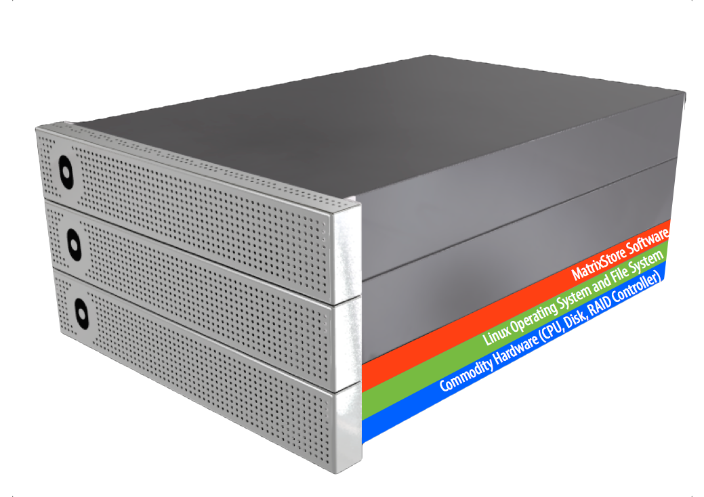
MatrixStore Enterprise Cluster
Contains a minimum of 3 MatrixStore nodes
Notes:
After the initial cluster is installed it is possible to add any size node to the cluster.

Slide 40
What is in a MatrixStore Node?
Intel
Off the shelf commodity components (CPU, Enterprise Drives, RAID6
Controller. GigE or 10GigE ports etc)
Standard Linux Operating System and File System
MatrixStore Software

Slide 41
Each MatrixStore Node is Responsible for:
Maintaining the protection levels of its own data
Participating in the health and load balancing of the overall cluster
Providing a searchable, in memory, database of its own data
MatrixStore PiP - Process in Place functionality enabling processing of data locally as and when required (Extraction of AS11 metadata etc.)
Notes:
Notes:
There is no head node which ensures the system scales.

Slide 42
What is a MatrixStore Vault?
MatrixStore objects are store in vaults. A vault is a secure virtual storage space within a MatrixStore cluster that allows data to be treated according to digital preservation policies set by the administrator. Policies that can be set include:
Number of copies in local cluster
Number of copies in remote cluster for disaster recovery purposes
Retention Period. Lock content down from accidental or malicious deletion
Vaults also provide a means by which to share storage infrastructure amongst departments, clients, projects or workflows.
Notes:
MatrixStore objects are stored in vaults.
A vault is a secure virtual storage space within a cluster that allows data to be treated according to the policies that are provisioned upon that vault. Vaults allow several departments within the same organisation to share the MatrixStore cluster whilst keeping their data protected data from unauthorised access. Vaults automatically make use of any new storage capacity that is added without any manual intervention thus providing a highly scalable storage platform that requires very little management.

Slide 43
MatrixStore hub, hub+
 | hub | hub+
Operating System | Ubuntu Server | Ubuntu Server
Supported Interfaces | SMBv2.002 | SMBv2.002
Connectivity | Dual GigE / 10GigE | Dual GigE / 10GigE
Number of Ports | 2,4 | 8, 12, 24
Power Consumption | 150-270W | 150-270W
Dimensions | 1u (Rack Mounted) | 1u (Rack Mounted)
Power | Dual (Redundant) | Dual (Redundant)
Notes:
Client Tools
1. DropSpot
2. MXFS
3. MatrixStoreConnect (FTP)
4. Move2 (backup MatrixStore content to deep archive like ODA or LTO)
5. InterConnect
6. LTO Plugin (currently implemented against Xendata API. Other APIs under consideration)

Slide 44
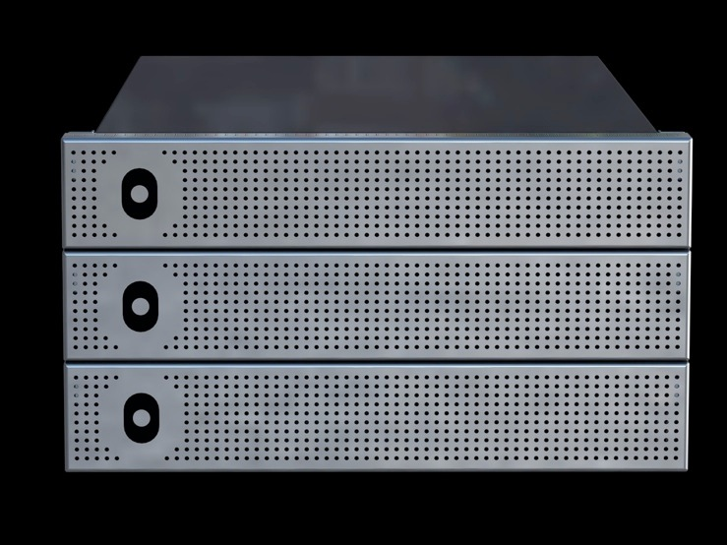
How Does a MatrixStore Cluster Scale?
24TB
24TB
24TB
The minimum configuration for a MatrixStore cluster is 3 nodes of the same capacity footprint.

Slide 45
48TB
36TB
36TB
24TB
24TB
24TB
After which nodes of any size or certified technology can be added to the cluster

Slide 46
How Does a MatrixStore Cluster Scale in Performance?
access node
client
o
client
o
Traditional architectures and even some object based solutions need some sort of head node, metadata controller or access node.
client
o
client
o
client
o
which can be limiting to scaling performance and capacity

Slide 47
access node
client
o
client
o
With MatrixStore there is no head node, network node or access node with expansion chassis to get in the way of true scaling
client
o
client
o
client
o
all MatrixStore nodes are connected to the network for direct client connections

Slide 48
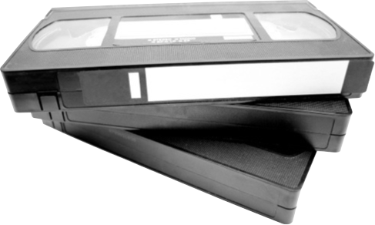
Metadata
This be the metadata
Notes:
Traditional MAMs, DAMS, PAMS do not share metadata and that metadata is not tightly coupled to the data itself meaning it can easily be lost

Slide 49
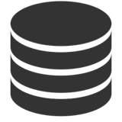
Metadata (Traditional Model)
MAM, DAM or PAM
Storage
points to location of assets
Metadata
points to location of assets
Deep Archive
Metadata not protected beyond simple MAM database backup
Metadata not easily accessed by third party applications
Metadata store to Deep Archive can be in proprietary format
Change to MAM system means data could be in danger of being disconnected or lost

Slide 50
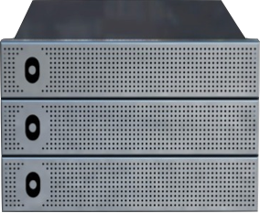
Metadata (MatrixStore Model)
MAM, DAM or PAM
MatrixStore
data & metadata
Deep Archive
Metadata
data & metadata
search metadata
3rd Party Apps
enrich metadata
MatrixStore protects the Essence and Metadata in non-proprietary format
Future proof access to content dependent on the Metadata
If the MAM changes the metadata can be automatically scanned an ingested
Able to extract key metadata from supported standards such as AS11 (DDPP)
Notes:
MatrixStore protects data and metadata

Slide 51
Metadata Forms
Custom metadata tagging and search forms offered by DropSpot application
Notes:
DropSpot used by 90% of Object Matrix Customers for non MAM/DAM/PAM workflows

Slide 52
Data Security & Integrity
Independently verified security protocols and practices
All transmitted data packets are fully encrypted(256-bit) and authenticated.
High resistance to ‘denial of service’ attacks
Strictly enforced user authentication
Safe from viruses
Tamper proof messaging
All content is has guaranteed integrity on ingest. Checksum generated is stored as metadata for ongoing integrity guarantee

Slide 53
Business Rules
Create policies on MatrixStore vaults to protect content in accordance with business needs
Lock vaults down to ensure data is not lost through accidental or malicious action
Retention periods can be set on vaults so data is locked down for a specific amount of time
Vaults can replicate data to a remote location for disaster recovery or data sharing

Slide 54
Multiple Tenancy
Allows many workflows, departments, customers or projects to independently use the same physical platform
Audio
Graphics
Customer
Ingest
Interplay
Proxies

Slide 55
Future Proof
Object Matrix uses non-proprietary platforms, operating systems, file systems & data formats
Add any qualified MatrixStore node to a cluster. No limit on node size
If Linux supports future hardware components, Object Matrix will qualify them
API and multiple interfaces (SMB etc) provides access to content from any workflow
Metadata stored in an open format providing access to content now and in the future

Slide 56
References
White paper
http://www.object-matrix.com/MatrixStoreTechnologyArchitecture.pdf
Small Videos
Object Storage: http://www.matrixstore.net/2014/05/19/object-storage-benefits-in-media-workflows-2/
What’s a MatrixStore node: http://www.matrixstore.net/2010/02/26/matrixstore-concepts-what-is-a-matrixstore-node/
How does MatrixStore scale: http://www.youtube.com/watch?v=BUWpit2EUyE
Digital Preservation: http://www.matrixstore.net/2010/03/16/the-matrixstore-pre-production-archive-for-file-based-content/

